Slide 1
CVSS Capstone Briefing
CVE-2009-0658
Name : Phillip Newlove
Date: 13/12/23

Slide 2
Scope
This briefing will cover a detailed breakdown of the CVSS score for CVE-2009-0658 in order to understand what the scoring means and how it was achieved.
My name is Phillip Newlove (Phil), I am a student of WYWM, I created the CVSS score and I will be explaining how and why I did each step.

Slide 3
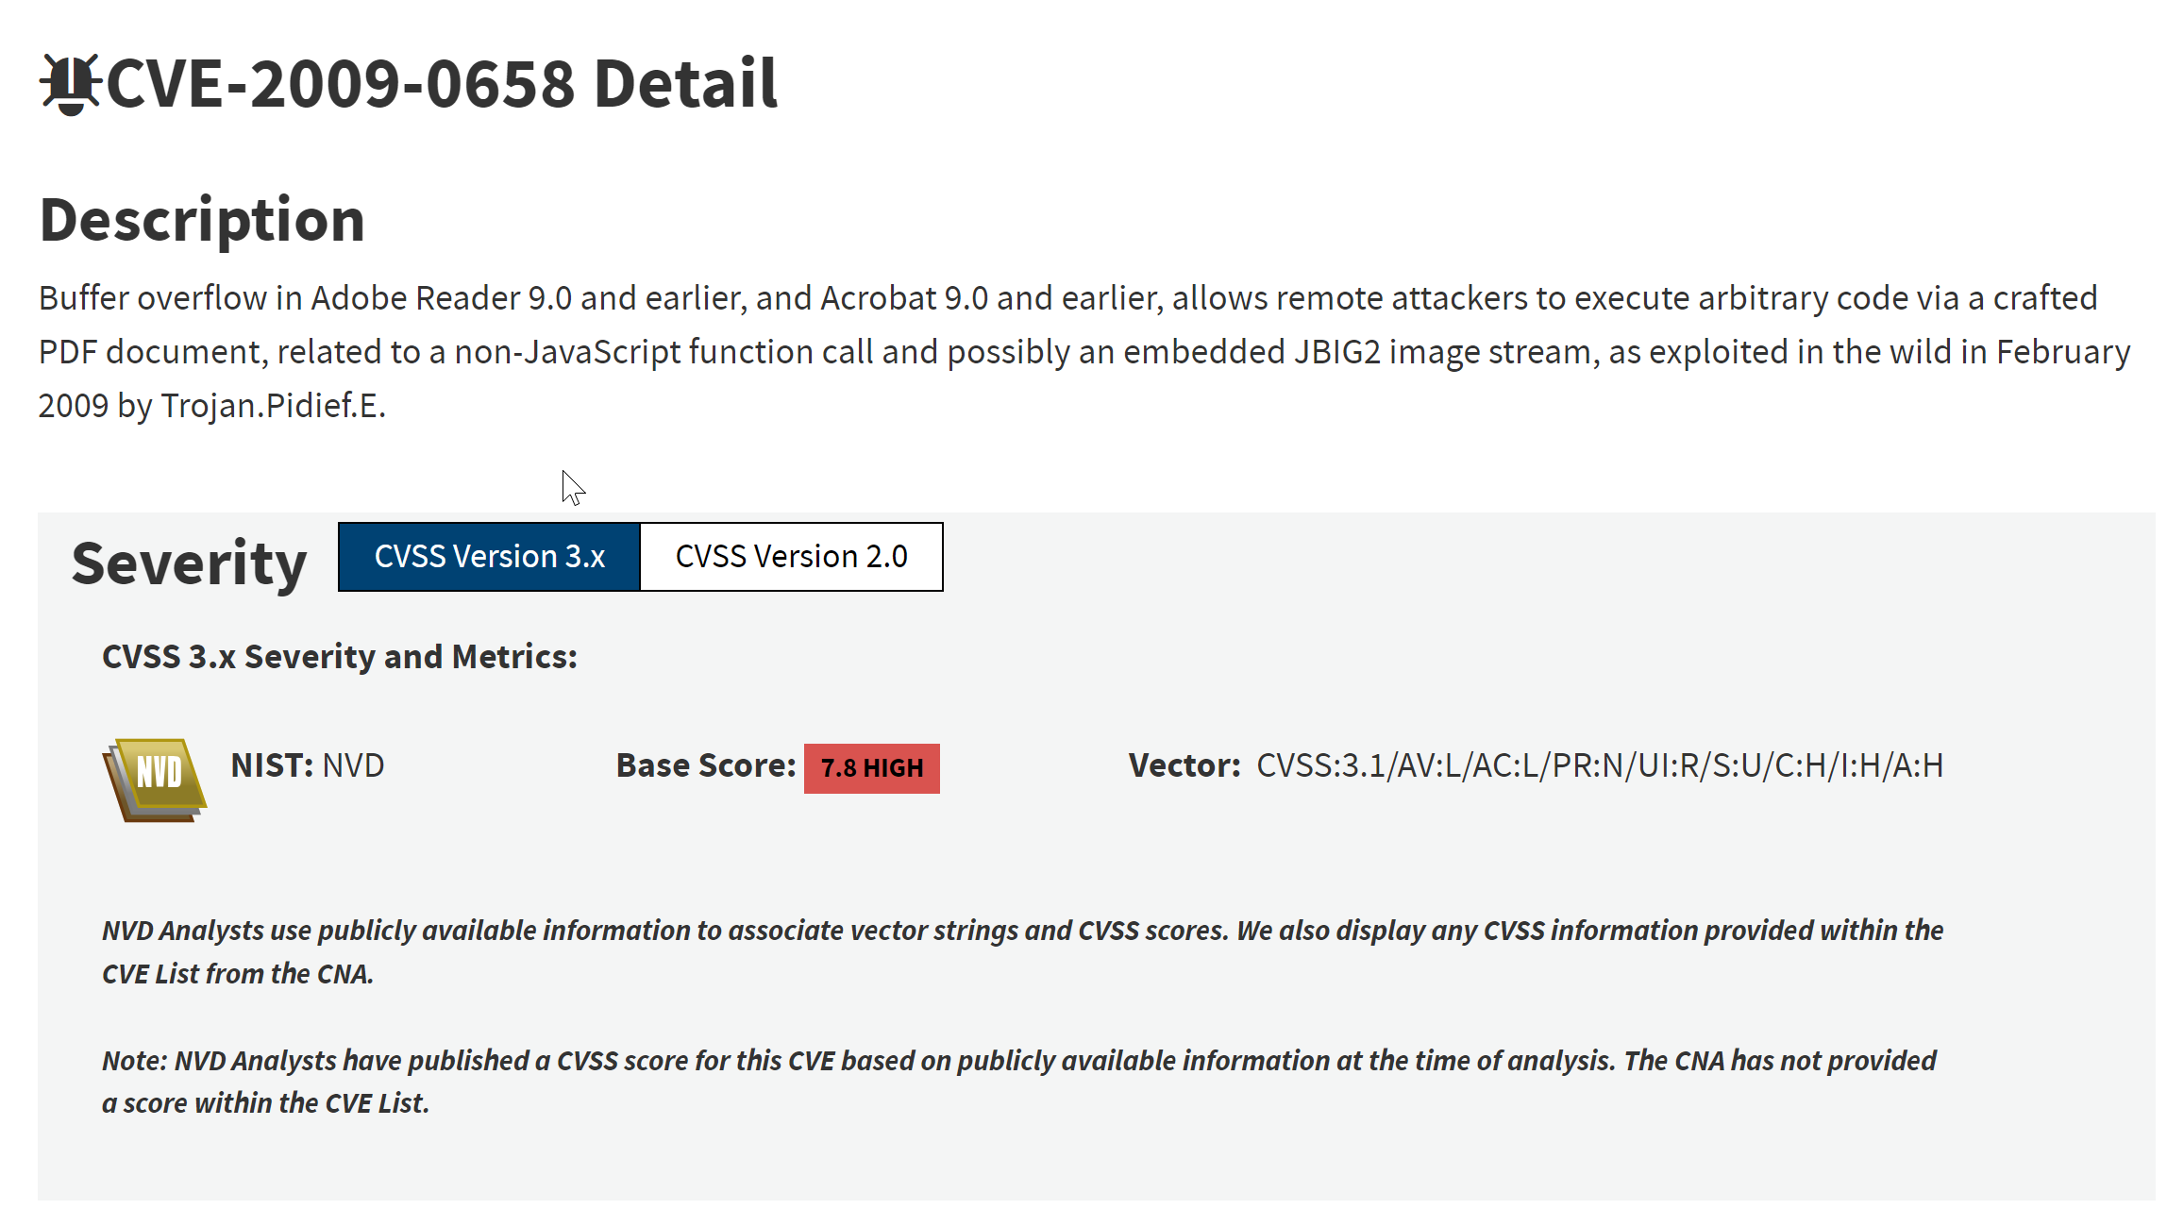
Threat

Slide 4
Threat Cont’d
CVE-2009-0658 is a buffer overflow vulnerability in Adobe Reader versions 9.0 and earlier. This allows arbitrary code to be executed on the system via a malicious PDF document that is opened by the user.
References - https://nvd.nist.gov/vuln/detail/CVE-2009-0658

Slide 5
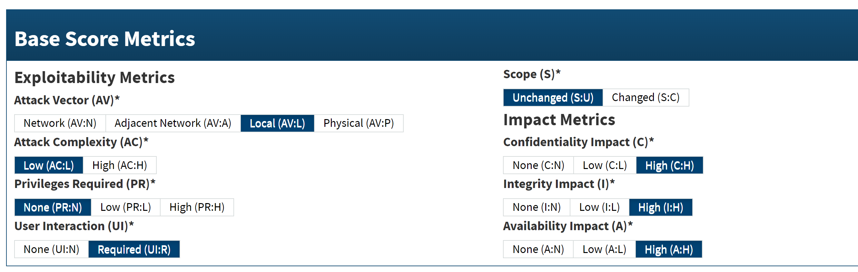
Base Score Metrics
Base Score : 7.8

Slide 6
Base Score Metrics Cont’d
I found the base score to be 7.8. This was based on:
Attack Vector : Local – I concluded this was a local attack vector since the exploit relied on uploading a file to the victim’s computer, which then had to be opened by a user locally.
Attack Complexity : Low – I scored this as low attack complexity since the only action required to trigger the exploit, is the user opening the malicious file.
Privileges Required : None – The attack requires no privileges from the attacker’s side, only the ability to send a file.
User Interaction : Required – The exploit requires the user to open the malicious file.
Scope : Unchanged – The arbitrary code executed on the target is dependent upon the privileges of the user that is exploited, resources out of reach of the user are also out of reach of the attacker.
Impact metrics – Confidentiality, Integrity and Availability all have a high chance of being impacted, depending on the target user’s privileges.

Slide 7
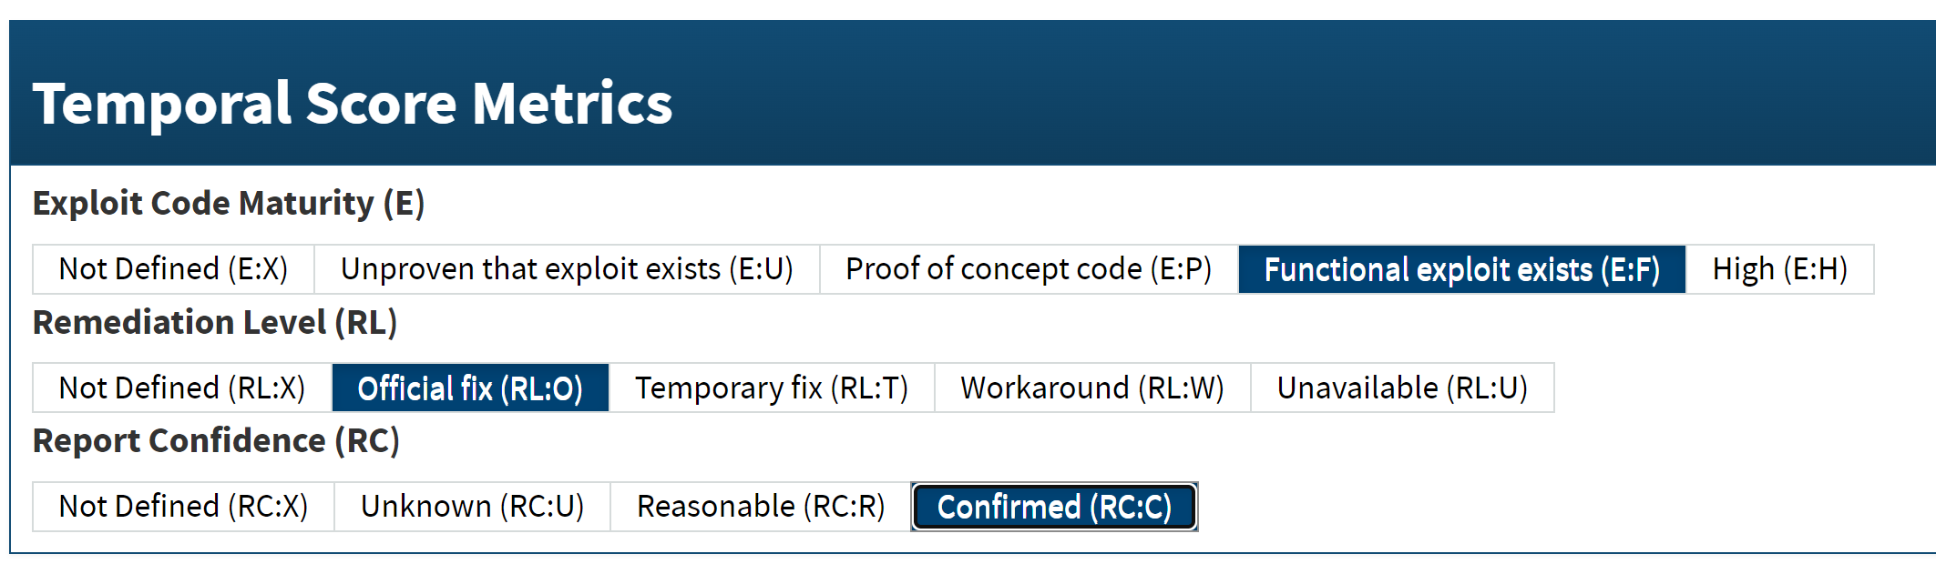
Temporal Score Metrics
Temporal Score : 7.2

Slide 8
Temporal Score Metrics Cont’d
I found the Temporal score to be 7.2. This was based on:
Exploit Code Maturity : Functional Exploit Exists – There are functional exploits on exploitDB (including Metasploit modules) (https://www.exploit-db.com/)
Remediation Level : Official Fix – Adobe have released an updated version of Acrobat and Reader to resolve this vulnerability (https://www.adobe.com/support/security/advisories/apsa09-01.html)
Report Confidence : Confirmed – There are multiple sources (including from the vendors themselves) detailing the vulnerability and its exploits (https://www.exploit-db.com/), (https://www.adobe.com/support/security/advisories/apsa09-01.html), (https://nvd.nist.gov/vuln/detail/CVE-2009-0658)

Slide 9
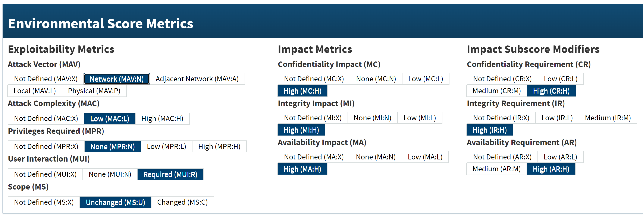
Environmental Score Metrics
Environmental Score : 8.2

Slide 10
Environmental Score Metrics Cont’d
I found the Environmental score to be 8.2. This was based on:
Attack Vector : Network – The malicious file is transferred across network boundaries and the code can be executed remotely.
Attack Complexity : Low – The only requirement for the attack to work is that the victim has a vulnerable Adobe version, then they download and open the file.
Privileges Required : None – The attacker is unauthorised and requires no access to settings or files.
User Interaction : Required – The user must download and open the file for the exploit to work.
Scope : Unchanged - The arbitrary code executed on the target is dependent upon the privileges of the user that is exploited, resources out of reach of the user are also out of reach of the attacker.
Impact Metrics – Confidentiality, Integrity and Availability all have a high chance of being impacted, depending on the target user’s privileges.
Impact Subscore Modifiers – Should an attacker launch a successful exploit against a privileged user, the impact to the business and its employees Confidentiality, Integrity and Availability could be severe and catastrophic.

Slide 11
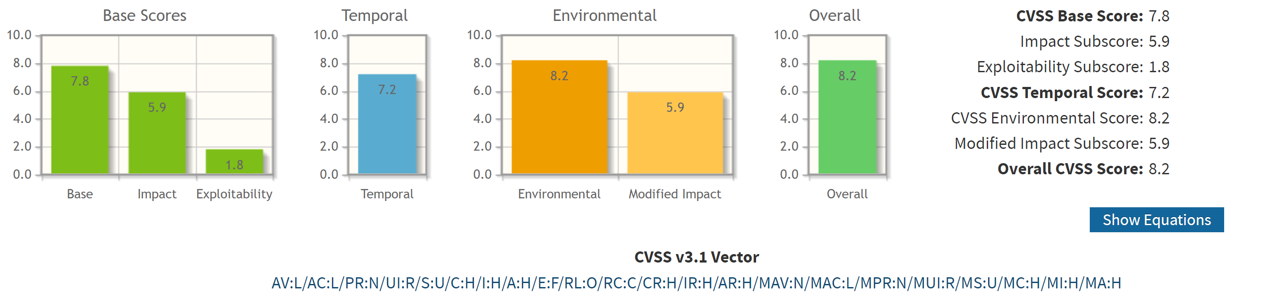
Overall Score
I found the overall score to be 8.2, this was taken from a combination of the base, temporal and environmental scores.
Overall Score : 8.2

Slide 12
Recommendations
To remediate vulnerability to this exploit I recommend:
Upgrade to Adobe reader and acrobat versions 9.1 or greater.
Update virus definitions
Exercise caution when receiving and opening PDF documents
If an attacker compromises a user with high level privileges (Administrator), this could enable them total and unrestricted access to all business, customer and employee data.

Slide 13
Conclusion
To summarise, we discussed:
What CVE-2009-0658 is and how it can affect a victim
The CVSS score, what it means and how it was created.
My recommendations to reduce the risk of an attack.

Slide 14

Questions?

